Slide 1

Java 15 New Features
Dima Ionut Daniel

Slide 2
Contents
What is Java?
History
Java Flavors
New Features
Core
Other Improvements
Bibliography

Slide 3

What is Java?
Java is a programming language created by Sun Microsystems.
Java is used in a wide variety of computing platforms from embedded devices and mobile phones on the low end, to enterprise servers and supercomputers on the high end.
Memory management is handled through integrated automatic garbage collection performed by the JVM.
The heart of the Java platform is the concept of a "virtual machine" that executes Java bytecode programs. This bytecode is the same no matter what hardware or operating system the program is running under.
There is a JIT(Just-In-Time) compiler within the Java Virtual Machine, or JVM. The JIT compiler translates the Java bytecode into native processor instructions at run-time and caches the native code in memory during execution.
The Java programs are cross-platform or platform independent, but the code of the Java Virtual Machines (JVM) that execute these programs is not.

Slide 4
History
The initial Java release was named Oak, and the first stable version was JDK 1.0.2, called Java 1.
JDK 1.0 - 23 January 1996
JDK 1.1 – 19 February 1997
J2SE 1.2 – 8 December 1998 (codename Playground)
J2SE 1.3 – 8 May 2000 (codename Kestrel)
J2SE 1.4 – 6 February 2002 (codename Merlin)
J2SE 5.0 – 30 September 2004 (codename Tiger)
Java SE 6 – 11 December 2006 (codename Mustang)
Java SE 7 – 7 July 2011(codename Dolphin)
Java SE 8 – 18 March 2014 (codename Spider)

Slide 5
History (cont.)
Java SE 9 – 21 September 2017
Java SE 10 – 20 March 2018
Java SE 11 – 25 September 2018
Java SE 12 – 19 March 2019
Java SE 13 – 17 September 2019
Java SE 14 – 17 March 2020
Java SE 15 – 16 September 2020

Slide 6
Java Flavors
The Java distribution comes in different flavors:
Java Card →run securely on smart cards and similar small-memory devices.
Java ME(Micro Edition) → Specifies several different sets of libraries (known as profiles) for devices with limited storage, display, and power capacities.
Java SE(Standard Edition) → for general-purpose use on desktop PCs, servers and similar devices.
Java EE(Enterprise Edition) → Java SE plus various APIs useful for multi-tier client–server enterprise applications.

Slide 7
New Features
JEP 339 - EdDSA Algorithm
JEP 384 - Records (Second Preview)
JEP 360 - Sealed Classes (Preview)
JEP 371 - Hidden Classes
JEP 375 - Pattern Matching for instanceof (Second Preview)
JEP 378 - Text Blocks (Standard)
JEP 383 - Foreign Memory API (Second Incubator)
JEP 374 - Disable and Deprecate Biased Locking
JEP 372 - Disable the Nashorn JavaScript Engine
JEP 381 - Remove the Solaris and SPARC Ports
JEP 385: - Deprecate RMI Activation for Removal

Slide 8
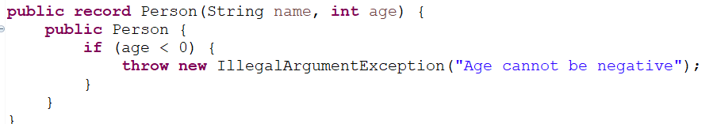
Core
Using the new record class, we can define the same immutable data object in a much more compact way.
The class definition has a new syntax that is specific for records.
This header is where we provide the details about the fields inside the record.
Using this header, the compiler can infer the internal fields.
While records eliminate a lot of boilerplate code, they do allow us to override some of the default behaviors.
Records do have some restrictions: they are always final, they cannot be declared abstract, and they can’t use native methods.

Slide 9

Core (cont.)
Currently, Java provides no fine-grained control over the inheritance. Access modifiers such as public, protected, private, as well as the default package-private, provide very coarse-grained control.
The goal of sealed classes is to allow individual classes to declare which types may be used as sub-types.
This also applies to interfaces and determining which types can implement them.
Sealed classes involve two new keywords: sealed and permits.
Any class that extends a sealed class must itself be declared sealed, non-sealed, or final.

Slide 10
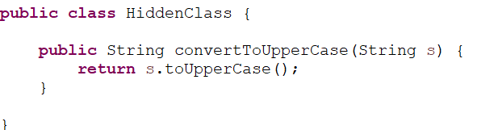
Core (cont.)
A new feature being introduced in Java 15 is known as hidden classes.
The goal of hidden classes is to allow the runtime creation of classes that are not discoverable.
This means they cannot be linked by other classes, nor can they be discovered via reflection.
Since there’s no actual name for a hidden class, its canonical name will be null.

Slide 11
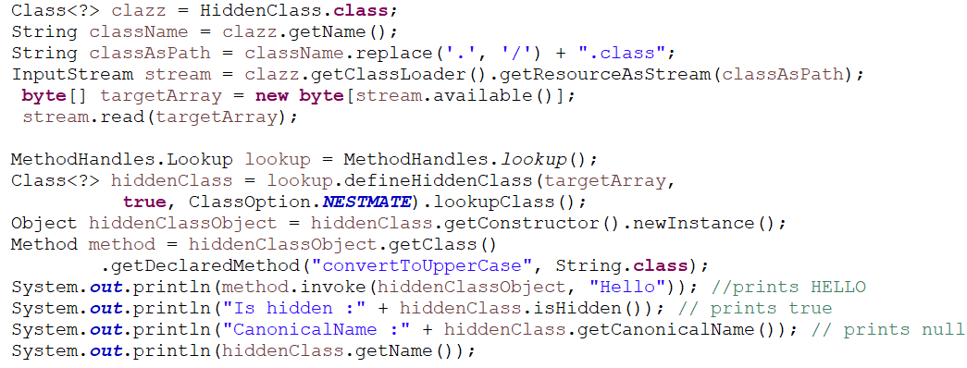
Core (cont.)
We use Lookup.defineHiddenClass to create a hidden class.

Slide 12
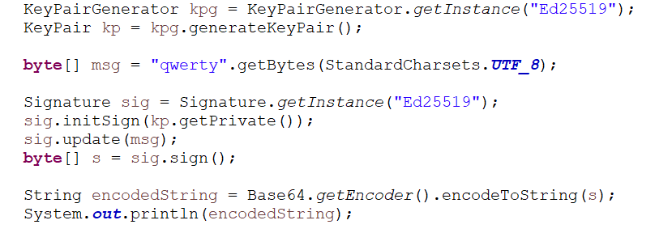
Core (cont.)
EdDSA (Edwards-Curve Digital Signature Algorithm) [RFC 8032] is another additional digital signature scheme added in Java 15 thorough JEP 339.
It provides much better performance and secure signatures in comparison to other available signature schemes.

Slide 13
Other Improvements
Foreign memory access is already an incubating feature of Java 14.
In Java 15, the goal is to continue its incubation status while adding several new features:
A new VarHandle API, to customize memory access var handles
Support for parallel processing of a memory segment using the Spliterator interface
Enhanced support for mapped memory segments
Ability to manipulate and dereference addresses coming from things like native calls

Slide 14
Other Improvements (cont.)
In Java 15, both ZGC (JEP 377) and Shenandoah (JEP 379) will be no longer be experimental.
Both will be supported configurations that teams can opt to use, while the G1 collector will remain the default.
Both were previously available using experimental feature flags.
This approach allows developers to test the new garbage collectors and submit feedback without downloading a separate JDK or add-on.

Slide 15
Other Improvements (cont.)
To accommodate additional dynamic languages in the JVM, the Nashorn JavaScript Engine was added to JDK 8 as a potential alternative for the Rhino scripting engine.
Since the launch of GraalVM, that area has become the centre of attention for multi-language support.
Although Nashorn was initially intended to be removed in Java 11, it remained a part of the JDK until JDK 14.

Slide 16
Other Improvements (cont.)
This release upgrades Unicode support to 13.0.
The VM option UseAdaptiveGCBoundary is obsolete. This option was previously disabled by default, and enabling it only had an effect when also using -XX:+UseParallelGC.
The legacy SunJSSE provider name, "com.sun.net.ssl.internal.ssl.Provider" has been removed and should no longer be used. The "SunJSSE" name should be used instead. For example, SSLContext.getInstance("TLS", "SunJSSE").
The implementation of the deprecated SSLSession.getPeerCertificateChain() method has been removed from the JDK in the SunJSSE provider and the HTTP client implementation. The default implementation of this method has been changed to throw UnsupportedOperationException.

Slide 17

Bibliography
http://en.wikipedia.org/wiki/Java_(programming_language)
https://www.baeldung.com/java-15-new
https://www.digitalocean.com/community/tutorials/java-15-features
https://www.javatpoint.com/what-is-new-in-java-15

